Slide 1
TRANSFORMER NETWORKS
Prof John Weirstrass MUTEBA MWAMBA

Slide 2

TRANSFORMER NETWORK MODELS

Slide 3
Transformer Network
The transformer (represented by the T in ChatGPT, GPT-2, GPT-3, GPT-3.5, etc.) is the key element that makes generative AI so, well, transformational.
Transformer models are a type of neural network architecture designed to process sequential material, such as sentences or time-series data.
The concept of a transformer was conceived in a 2017 paper by researchers from Google and University of Toronto (Canada). The paper is titled” “Attention Is All You Need” (Ashish Vaswani et al. 2017).
Since then, in the realms of AI and machine learning, transformer models have emerged as a groundbreaking approach to various language-related tasks.

Slide 4
Transformer Architecture
Transformers can be used to write stories, essays, poems, answer questions, translate between languages, chat with humans, and they can even pass exams that are hard for humans!
The transformer has 4 main parts:
Tokenization
Embedding
Positional encoding
Transformer block (including Attention mechanism & feed-ward blocks)
Softmax

Slide 5
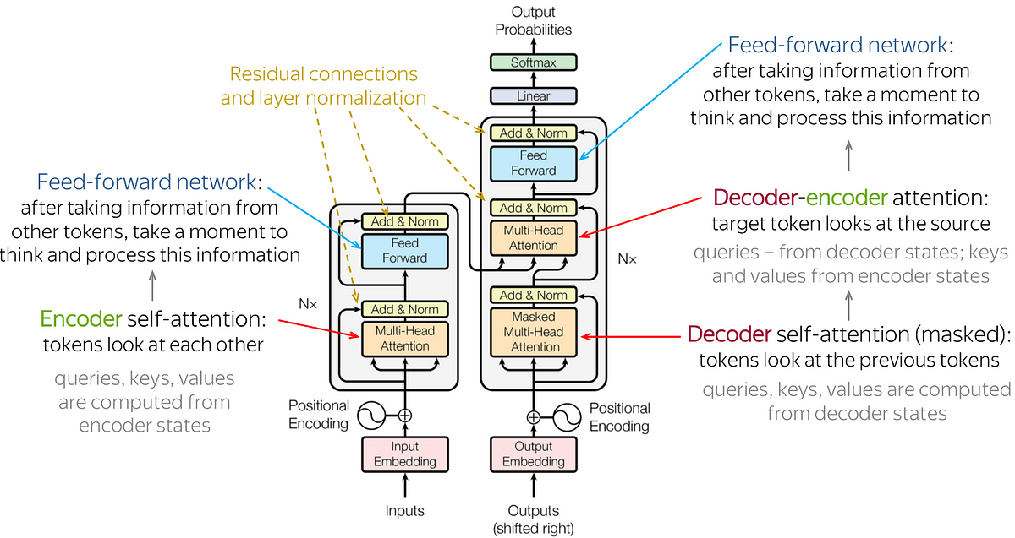
Transformer Architecture

Slide 6
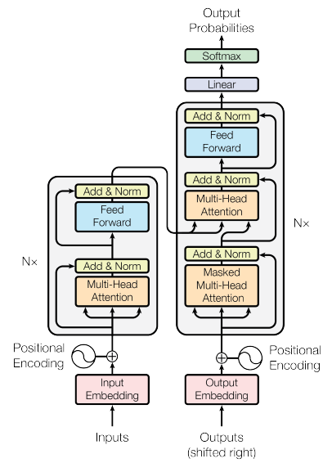
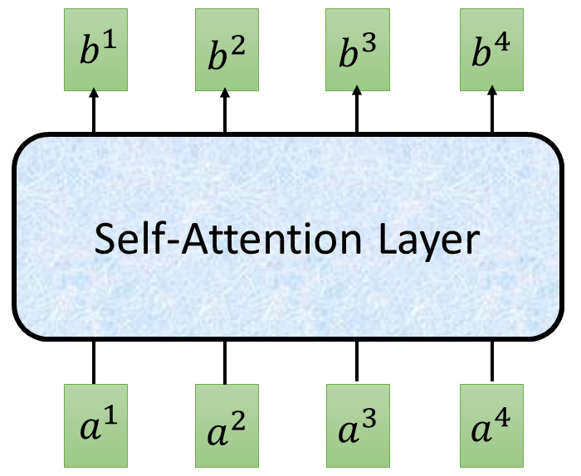
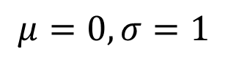
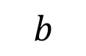
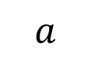
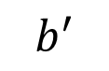
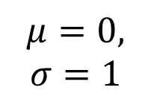
Transformer -Architectire
Batch Size
Layer
Norm
$$b^{′}$$
$$μ=0,$$
$$σ=1$$
+
Batch
$$b$$
$$μ=0,σ=1$$
Layer
…
$$a$$
attend on the input sequence
Masked: attend on the generated sequence
Notes:
(two layer2, with one relu)

Slide 7
Background (1)
The RNN and LSTM neural models were designed to process language and perform tasks like classification, summarization, translation, and sentiment detection
RNN: Recurrent Neural Network
LSTM: Long Short Term Memory
In both models, layers get the next input word and have access to some previous words, allowing it to use the word’s left context
They used word embeddings where each word was encoded as a vector of 100-300 real numbers representing its meaning

Slide 8
Background (2)
Transformers extend this to allow the network to process a word input knowing the words in both its left and right context
This provides a more powerful context model
Transformers add additional features, like attention, which identifies the important words in this context
And break the problem into two parts:
An Encoder
A Decoder

Slide 9
Transformer - THE ENCODER PART
The encoder maps an input sequence into an abstract continuous representation that holds all the learned information of that input.
Encoder
Decoder

Slide 10

1 - Tokenization
Tokenization is the most basic step. It consists of a large dataset of tokens, including all the words, punctuation signs, etc.
The tokenization step takes every word, prefix, suffix, and punctuation signs, and sends them to a known token from the library.
Example:

Slide 11
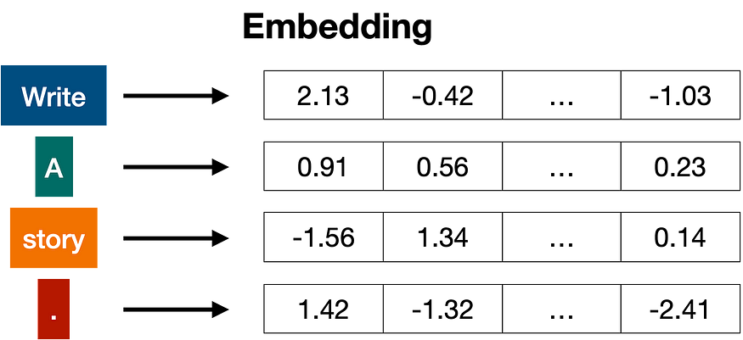
2 - Embeddings
Once the input has been tokenized, it’s time to turn words into numbers. For this, we use an embedding.
It creates vector representation of each sequence vocabulary/word
Notes:
Already tokenized, main idea is getting to model dimension,
Do this through a learned mapping
Since this is learned, it will superimpose important context

Slide 12
3 - Positional encoding
The most common way to turn a bunch of vectors into one vector is to add them, componentwise.
That means, we add each coordinate separately. For example, if the vectors (of length 2) are [1,2], and [3,4], their corresponding sum is [1+3, 2+4], which equals [4, 6].
This can work, but there’s a small caveat.
Addition is commutative, meaning that if you add the same numbers in a different order, you get the same result.
In that case, the sentence “I’m not sad, I’m happy” and the sentence “I’m not happy, I’m sad”, will result in the same vector, given that they have the same words, except in different order.
This is not good. Therefore, we must come up with some method that will give us a different vector for the two sentences. Several methods work, and we’ll go with one of them: positional encoding.

Slide 13
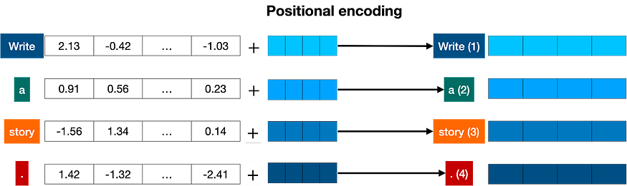
3 - Positional encoding 2
Positional encoding consists of adding a sequence of predefined vectors to the embedding vectors of the words. This ensures we get a unique vector for every sentence, and sentences with the same words in different order will be assigned different vectors.
In the example below, the vectors corresponding to the words “Write”, “a”, “story”, and “.” become the modified vectors that carry information about their position, labeled “Write (1)”, “a (2)”, “story (3)”, and “. (4)”.

Slide 14



3 - Positional encoding 3
Positional encoding
What?
Add information about an element’s position in a sequence to its representation
Why?
Removes need for recurrence or convolution
How?
Element wise addition of sinusoidal encoding
$$x_{i}$$
$$PE_{i}$$
+
=
$$z_{i}$$
Positional Encoding
Notes:
Positional encoding is essential for this architecture.
Adds in positional context so that we don’t need to gather it.
Because this goes through a NN down the line, this becomes further superimposed and manipulated
Authors also experimented with learned positional encoding but have same performance and suggest that model doesn’t generalize as well with this format when evaluated on different sequence lengths than those seen during training.
Fixed dim means we can add them together

Slide 15
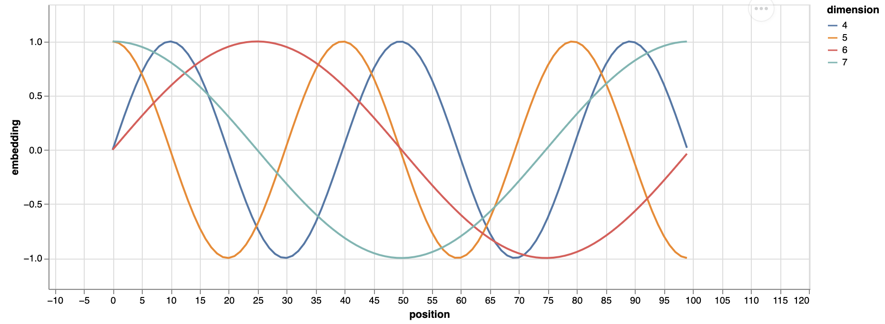
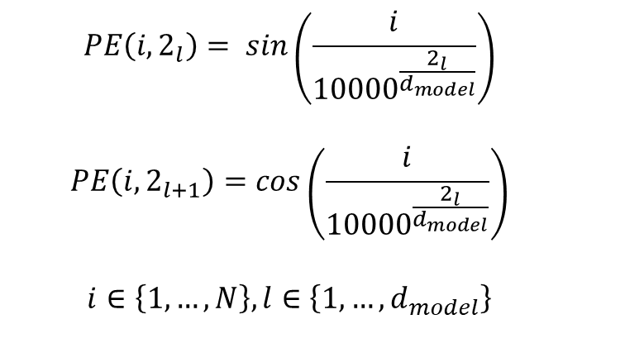
3 - Positional encoding 3
Sinusoidal positional encoding
“May allow the model to easily learn to attend by relative positions”
$$PE\left(i,2_{l}\right)= sin\left(\frac{i}{{10000}_{ }^{\frac{2_{l}}{d_{model}}}}\right)$$
$$PE\left(i,2_{l+1}\right)=cos\left(\frac{i}{{10000}_{ }^{\frac{2_{l}}{d_{model}}}}\right)$$
$$i∈\left\{1, …, N\right\}, l∈\left\{1, …, d_{model}\right\}$$
Notes:
Authors also experimented with learned positional encoding but have same performance and suggest that model doesn’t generalize as well with this format when evaluated on different sequence lengths than those seen during training.
for any fixed offset kk, PEpos+kPEpos+k​ can be represented as a linear function of PEposPEpos​.
i is pos in sequence
L is dim in d_model

Slide 16
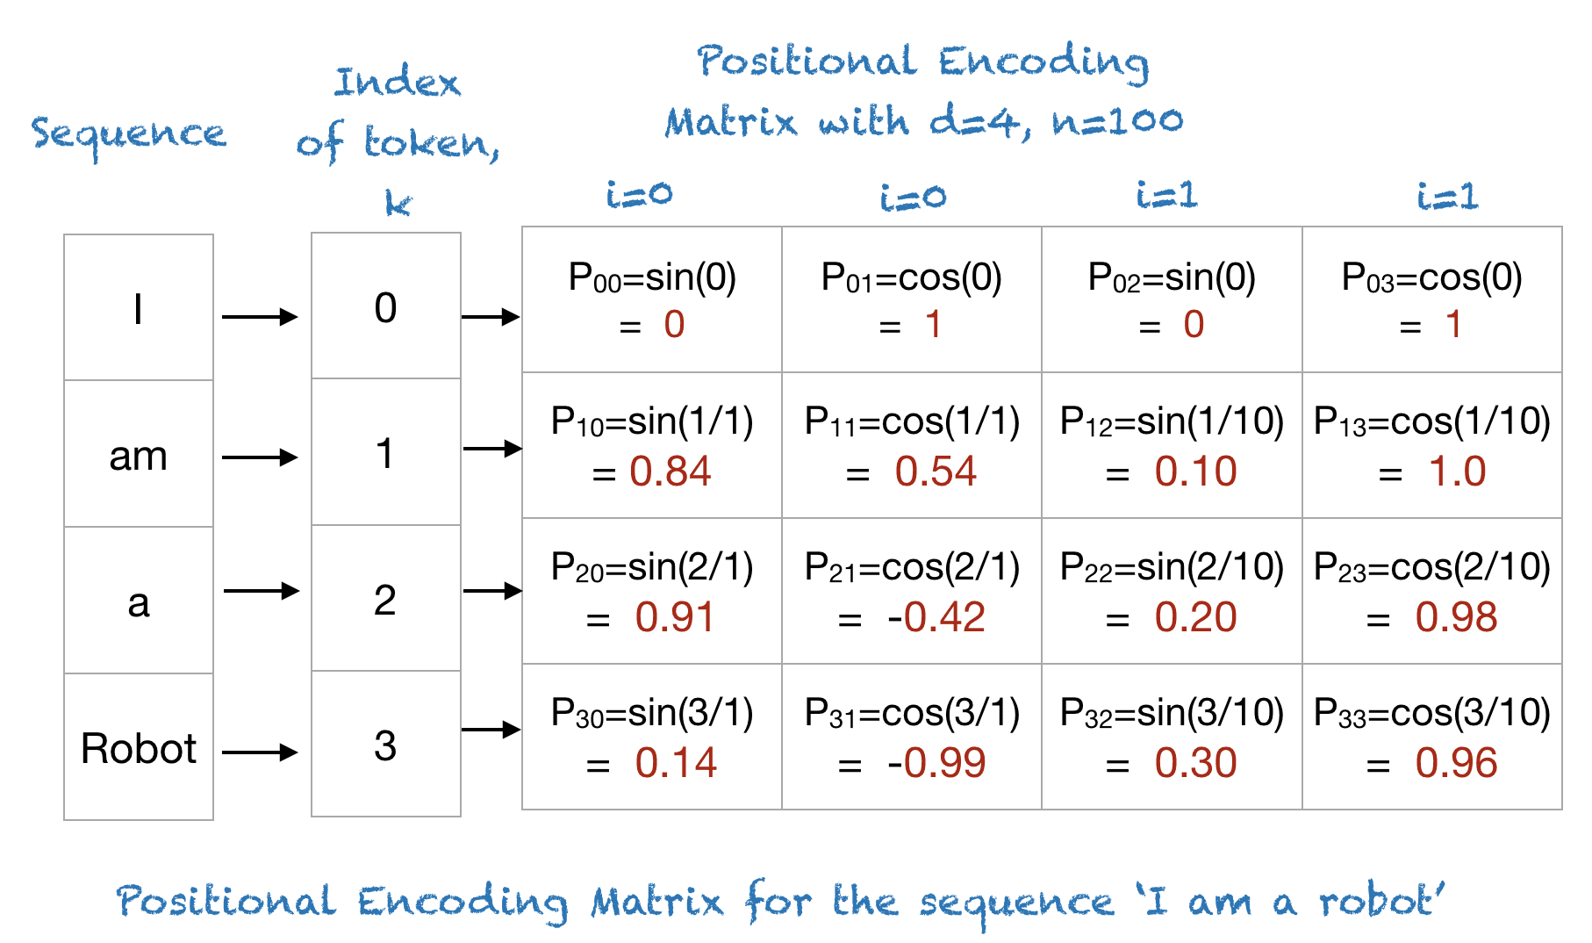
Example of Positional Encoding .
To understand the above expression, let’s take an example of the phrase “I am a robot,” with n=100 and d=4. The following table shows the positional encoding matrix for this phrase. In fact, the positional encoding matrix would be the same for any four-letter phrase with n=100 and d=4

Slide 17
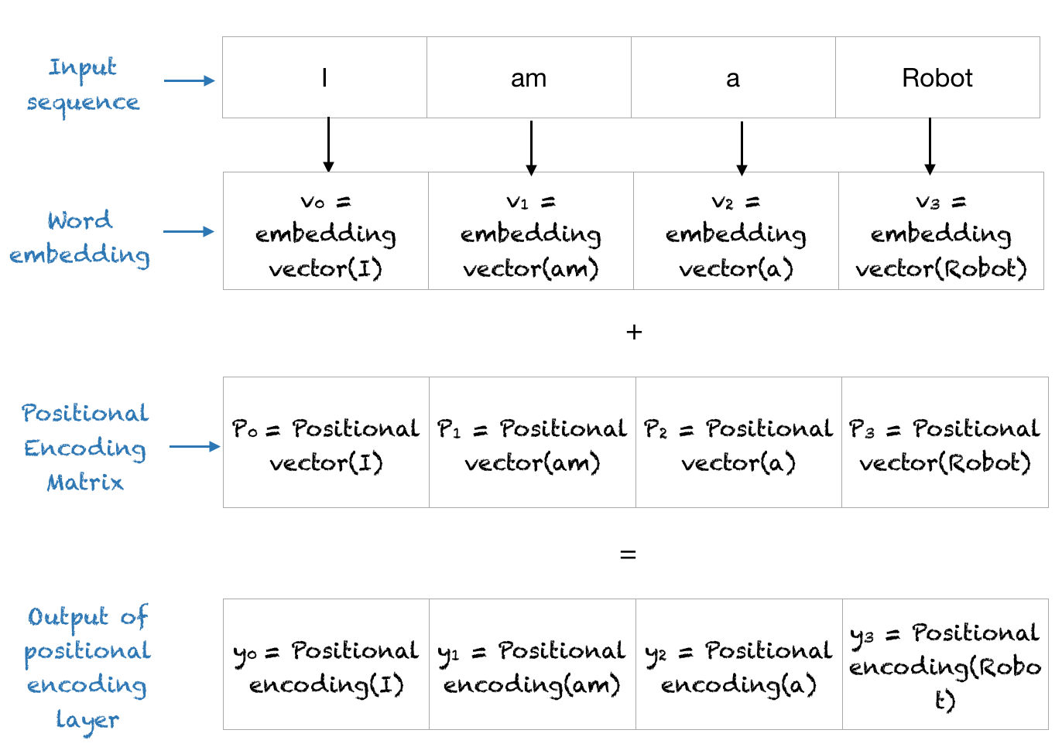
The Final Output of the Positional Encoding Layer
The positional encoding layer sums the positional vector with the word encoding and outputs this matrix for the subsequent layers. The entire process is shown below.

Slide 18
Self-Attention Layer
same word can be used with different meanings. This tends to confuse language models, since an embedding simply sends words to vectors, without knowing which definition of the word they’re using.
Attention is a very useful technique that helps language models understand the context.
Example: consider the following two sentences: “The bank of the river.”, and “Money in the bank.”
The word ‘bank’ appears in both, but with different meanings: in the 1st sentence the word ‘river’ let us know that we’re talking about the land. In the 2nd sentence the word ‘money’ let us know that we are referring to a financial institution.
Notes:
In order to understand how attention works, consider the following two sentences:
Sentence 1: The bank of the river.
Sentence 2: Money in the bank.
As you can see, the word ‘bank’ appears in both, but with different definitions. In sentence 1, we are referring to the land at the side of the river, and in the second one to the institution that holds money. The computer has no idea of this, so we need to somehow inject that knowledge into it. What can help us? Well, it seems that the other words in the sentence can come to our rescue. For the first sentence, the words ‘the’, and ‘of’ do us no good. But the word ‘river’ is the one that is letting us know that we’re talking about the land at the side of the river. Similarly, in sentence 2, the word ‘money’ is the one that is helping us understand that the word ‘bank’ is now referring to the institution that holds money.

Slide 19
Self-Attention Layer
What attention does in these 2 sentences is to move the key words in a sentence closer in the word embedding.
This way, the word “bank” in the 1st sentence will be moved closer to the word “money”.
Equivalently, in the 2nd sentence, the word “bank” will be moved closer to the word “river”.
That way, the modified word “bank” in each of the two sentences will carry some of the information of the neighboring words, adding context to it.

Slide 20
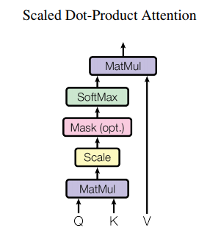
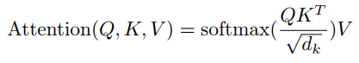
Self-Attention Layer
Scaled Dot-Product Attention:
The operations involved within Self-Attention Layer ara all based on Matrix multiplication.
It consists in computing 3 vectors (Query) Q, (Key) K, and (Value) V
Q: queries, K: keys, V: values

Slide 21
Self-Attention Layer
Calculate Query, Key and Value of this self attention respectively.
q ⁱ (Query) = W ᑫ a ⁱ
k ⁱ (Key) = W ᵏ a ⁱ
v ⁱ (Value) = W ᵛ a ⁱ
W ᑫ, W ᵏ, W ᵛ is the target to train in a layer. Attention is combinations of Query and Key, where Query act as giver and Key act as receiver.
Value can be seen as information extractors, will extract a unique value based on attentions of words
EXAMPLE: “LSC is the best”

Slide 22
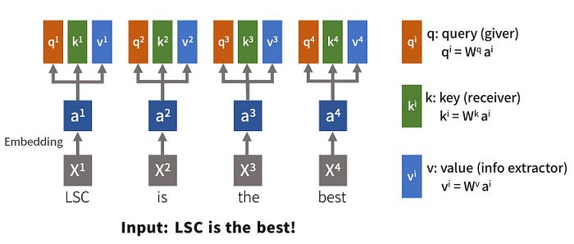
Self-Attention Layer
Self-Attention-Basic Structure:
For every input x, the words in x are embed into vector a as Self-Attention input.

Slide 23
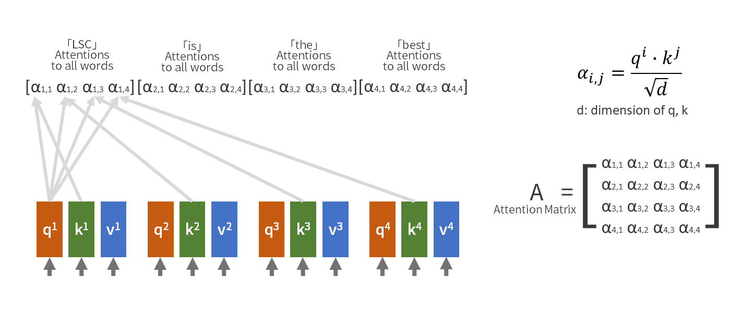
Self-Attention Layer
Attentions α are defined as inner product of Query(giver) and Key(receiver) divided by square root of its dimensions. Every word create its attention toward all words by providing Query to match Key which is target word of attention.
Since longer sentence (more words) results in bigger number of inner products, the square root here act as a variance balance. Attention Matrix A will generated.

Slide 24
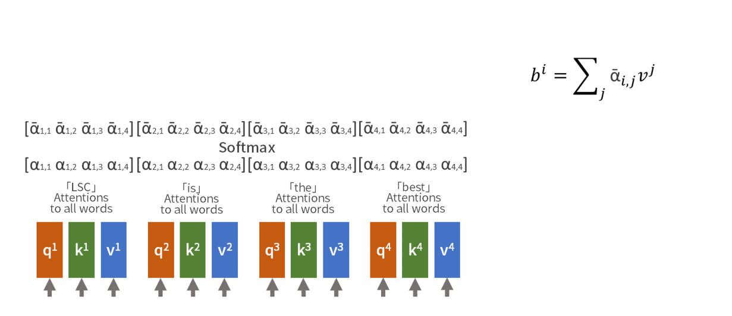
Self-Attention Layer
Next we apply softmax function through A by row (input words). Output b is calculated by sum of attentions multiply by extract information from Value of each word paid attention to.
The Self-Attention Layer constructs the relationships and extract information by itself via 3 variances: Query, Key and Value.
Query and Key construct the relationships, Value summarize all relations within and concludes an output b which contains relations between input x and all other words.

Slide 25
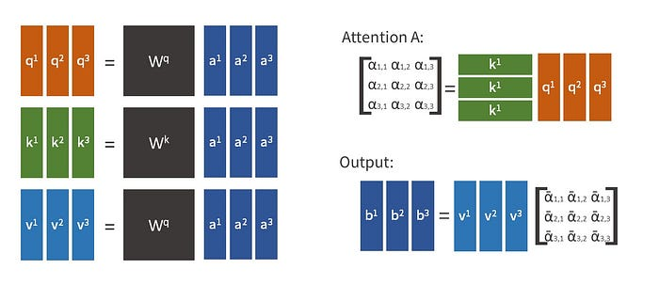
Self-Attention Layer –Matrix Form
Every calculations within Self-Attention Layer is Matrix Computations.

Slide 26
Multi-Head Attention
Since the relations between words may consist more than one types. For Instance, check the two sentences below:
“LSC is the best!”
“It’s the best of LSC.”
In these two sentences, the relation between “LSC” and “best” is quite difference, they shouldn’t be treated the same in attentions.
And also, distance between words should considered by attentions too.

Slide 27
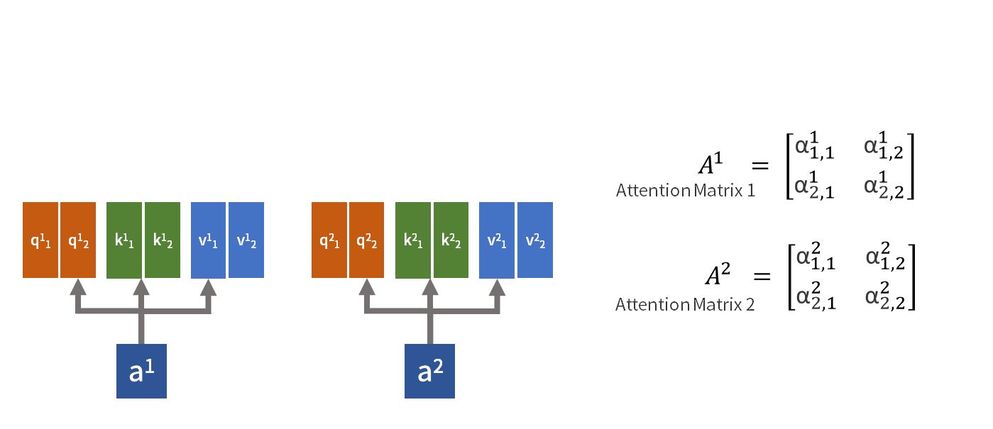
Multi-Head Attention
Multi-Head is features that can create multiple Attentions Matrix in one layer. By simply double the Query, Key and Value combinations in Self-Attention Layer, and independently calculates Attention Matrix.
With Multiple-Head, the Self-Attention Layer would create multiple outputs.
Therefore, there will be another trainable weights Wᵒ, so that O = WᵒB where B is outputs of different Attentions.

Slide 28
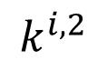
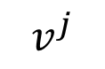
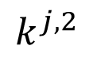
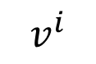
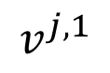
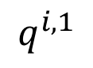
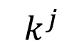
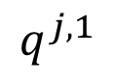
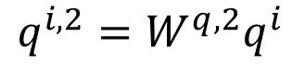
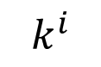
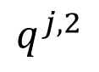
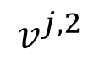
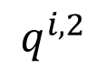
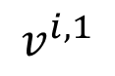
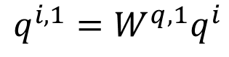
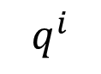
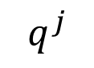
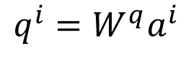
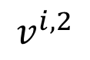
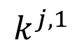
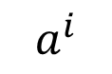
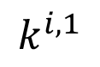
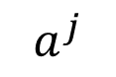
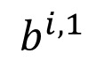
Multi-head Self-attention
(2 heads as example)
$$q^{i,1}=W^{q,1}q^{i}$$
$$b^{i,1}$$
$$q^{i,2}=W^{q,2}q^{i}$$
$$q^{i,1}$$
$$q^{i,2}$$
$$k^{i,1}$$
$$k^{i,2}$$
$$v^{i,1}$$
$$v^{i,2}$$
$$q^{j,1}$$
$$q^{j,2}$$
$$k^{j,1}$$
$$k^{j,2}$$
$$v^{j,1}$$
$$v^{j,2}$$
$$q^{i}$$
$$k^{i}$$
$$v^{i}$$
$$q^{j}$$
$$k^{j}$$
$$v^{j}$$
$$q^{i}=W^{q}a^{i}$$
$$a^{i}$$
$$a^{j}$$

Slide 29
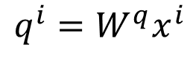
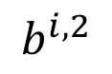
Multi-head Self-attention
(2 heads as example)
$$q^{i,1}=W^{q,1}q^{i}$$
$$b^{i,1}$$
$$q^{i,2}=W^{q,2}q^{i}$$
$$b^{i,2}$$
$$q^{i,1}$$
$$q^{i,2}$$
$$k^{i,1}$$
$$k^{i,2}$$
$$v^{i,1}$$
$$v^{i,2}$$
$$q^{j,1}$$
$$q^{j,2}$$
$$k^{j,1}$$
$$k^{j,2}$$
$$v^{j,1}$$
$$v^{j,2}$$
$$q^{i}$$
$$k^{i}$$
$$v^{i}$$
$$q^{j}$$
$$k^{j}$$
$$v^{j}$$
$$q^{i}=W^{q}x^{i}$$
$$a^{i}$$
$$a^{j}$$

Slide 30
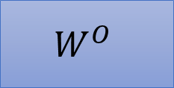
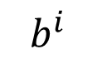
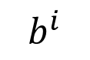


Multi-head Self-attention
(2 heads as example)
$$b^{i,1}$$
$$b^{i}$$
$$b^{i,1}$$
$$b^{i,2}$$
$$b^{i}$$
=
$$W^{O}$$
$$b^{i,2}$$
$$q^{i,1}$$
$$q^{i,2}$$
$$k^{i,1}$$
$$k^{i,2}$$
$$v^{i,1}$$
$$v^{i,2}$$
$$q^{j,1}$$
$$q^{j,2}$$
$$k^{j,1}$$
$$k^{j,2}$$
$$v^{j,1}$$
$$v^{j,2}$$
$$q^{i}$$
$$k^{i}$$
$$v^{i}$$
$$q^{j}$$
$$k^{j}$$
$$v^{j}$$
$$a^{i}$$
$$a^{j}$$

Slide 31


Multi-Head Attention structure
Multi-Head Attention Architecture
The total computational cost is similar to that of single-head attention with full dimensionality.

Slide 32
VISUAL REPRESENTATION OF OPERATIONS IN THE ENCODER SIDER

Slide 33

SELF-ATTENTION LAYER
Six stages are described in this Block with these (Q,K, V): MatMul, Scale, Softmax, MatMul, Concat, and Linear (normalization)

Slide 34

Stage 1: MatMult (QxK) – Example with 3 inputs
Computing the Score Matrix with Query, and Keys,

Slide 35

Visual Example: Q*K
The score matrix determines how much focus should a word be put on other words.
So each word will have a score that corresponds to other words in the time-step. The higher the score the more focus
EXAMPLE: “Hi how are you”

Slide 36

Stage 2: Scale – scaling the resulting Attention Matrix (Q*K)

Slide 37

Stage 3: Softmax of the Scaled Attention Score Matrix
Take the softmax of the scaled score matrix to get the attention weights, which gives you probability values between 0 and 1. By doing a softmax the higher scores get heighten, and lower scores are depressed. This allows the model to be more confident about which words to attend too.

Slide 38

Stage 4: MatMul - Multiply Attention score matrix with Value vector
take the attention weights and multiply it by your value vector to get an output vector. The higher softmax scores will keep the value of words the model learns is more important. The lower scores will drown out the irrelevant words. Then you feed the output of that into a linear layer to process.
This output vector is used in the next stage - The Residual Connections, Layer Normalization, and Feed Forward Network

Slide 39

NB: we can also Compute Multi-Head Attention
To make this a multi-headed attention computation, you need to split the query, key, and value into N vectors before applying self-attention. The split vectors then go through the self-attention process individually.
Each self-attention process is called a head. Each head produces an output vector that gets concatenated into a single vector before going through the final linear layer.
In theory, each head would learn something different therefore giving the encoder model more representation power.

Slide 40

Stage 5: The Residual Connections, Layer Normalization, and Feed Forward Network
The multi-headed attention output vector is added to the original positional input embedding. This is called a residual connection. The output of the residual connection goes through a layer normalization.

Slide 41

Stage 6: The Residual Connections, Layer Normalization, and Feed Forward Network
The normalized residual output gets projected through a pointwise feed-forward network for further processing. The pointwise feed-forward network is a couple of linear layers with a ReLU activation in between. The output of that is then again added to the input of the pointwise feed-forward network and further normalized.

Slide 42
Conclusion on the Encoder side
That wraps up the encoder layer: all of these operations are to encode the input to a continuous representation with attention information.
This will help the decoder focus on the appropriate words in the input during the decoding process.
You can stack the encoder N times to further encode the information, where each layer has the opportunity to learn different attention representations therefore potentially boosting the predictive power of the transformer network.

Slide 43
Transformer - THE DECODER PART
The decoder then takes that continuous representation and step by step generates a single output while also being fed the previous output
Encoder
Decoder

Slide 44
The Decoder Part
The decoder’s job is to generate text sequences.
The decoder has a similar sub-layer as the encoder.
it has two multi-headed attention layers, a pointwise feed-forward layer, and residual connections, and layer normalization after each sub-layer.
These sub-layers behave similarly to the layers in the encoder part but each multi-headed attention layer has a different job.
The decoder is capped off with a linear layer that acts as a classifier, and a softmax to get the word probabilities.

Slide 45

The Decoder Part Mechanism
The decoder is autoregressive, it begins with a start token, and it takes in a list of previous outputs as inputs, as well as the encoder outputs that contain the attention information from the input.
The decoder stops decoding when it generates a token as an output.
The decoder is autoregressive as it generates a token 1 at a time while being fed in the previous outputs.
Notes:
The entire text from the encoder part is feed to the encoder, but Attention is place on the token YOU, then ARE, then HOW, for each token the Q, K, are provided and a corresponding token is generated based on the “Value V”. For example for Token YOU, given its Q, K, V a new token is generated “I”. Then this newly generated token “I” is fed to the Encoder part as input,. Then given the “are” and its Q,K,V , a new token “am” is generated and fed to the encoder as new input =“I am”, etc.

Slide 46
Decoder Input Embeddings & Positional Encoding
The beginning of the decoder is pretty much the same as the encoder.
The input goes through an embedding layer and positional encoding layer to get positional embeddings.
The positional embeddings get fed into the first multi-head attention layer which computes the attention scores for the decoder’s input.

Slide 47

Decoders First Multi-Headed Attention
This multi-headed attention layer operates slightly differently. Since the decoder is autoregressive and generates the sequence word by word, you need to prevent it from conditioning to future tokens.
For example, when computing attention scores on the word “am”, you should not have access to the word “fine”, because that word is a future word that was generated after.
The word “am” should only have access to itself and the words before it. This is true for all other words, where they can only attend to previous words.
Notes:
NB: this computation is done parallely e.i. “I am fine” is generated simultaneously each token operation is done o a separate computation on the GPU! At this stage a new Masked Multi-head attention is computed. It is masked as to not show the next word to the network.

Slide 48

Look-Ahead Mask
The mask is a matrix that’s the same size as the attention scores filled with values of 0’s and negative infinities.
When you add the mask to the scaled attention scores, you get a matrix of the scores, with the top right triangle filled with negativity infinities
Notes:
We need a method to prevent computing attention scores for future words. This method is called masking. To prevent the decoder from looking at future tokens, you apply a look ahead mask. The mask is added before calculating the softmax, and after scaling the scores.
Look-Ahead Mask is a matrix of the same size as Attention score matrix and has zero on the diagonal and below it, and –infinity above diagonal line.
The Masked Attention Scores matrix = sum of the original attention score matrix + the look-ahead mask.

Slide 49

Softmax of the masked scores
The reason for the mask is because once you take the softmax of the masked scores, the negative infinities get zeroed out, leaving zero attention scores for future tokens. As you can see in the figure below, the attention scores for “am”, has values for itself and all words before it but is zero for the word “fine”. This essentially tells the model to put no focus on those words.

Slide 50
Softmax of the masked scores
This masking is the only difference in how the attention scores are calculated in the first multi-headed attention layer.
This layer still has multiple heads, that the mask is being applied to, before getting concatenated and fed through a linear layer for further processing.
The output of the first multi-headed attention is a masked output vector with information on how the model should attend on the decoder’s input.

Slide 51

Multi-Headed Attention with Masking
The second multi-headed attention layer. For this layer, the encoder’s outputs are the queries and the keys, and the first multi-headed attention layer outputs are the values.
This process matches the encoder’s input to the decoder’s input, allowing the decoder to decide which encoder input is relevant to put a focus on. The output of the second multi-headed attention goes through a pointwise feedforward layer for further processing.

Slide 52
Decoder Second Multi-Headed Attention, and Point-wise Feed Forward Layer
The second multi-headed attention layer.
For this layer, the encoder’s outputs are the queries and the keys, and the first multi-headed attention layer outputs are the values.
This process matches the encoder’s input to the decoder’s input, allowing the decoder to decide which encoder input is relevant to put a focus on.
The output of the second multi-headed attention goes through a pointwise feedforward layer for further processing.

Slide 53

Linear Classifier and Final Softmax for Output Probabilities
The output of the final pointwise feedforward layer goes through a final linear layer, that acts as a classifier.
The classifier is as big as the number of classes you have. For example, if you have 10,000 classes for 10,000 words, the output of that classier will be of size 10,000. The output of the classifier then gets fed into a softmax layer, which will produce probability scores between 0 and 1. We take the index of the highest probability score, and that equals our predicted word.

Slide 54

Softmax Output - Example
The softmax layer turns the scores into probabilities, and these are used to pick the next word in the text.

Slide 55

The Decoder Output
The decoder takes the output, adds it to the list of decoder inputs, and continues decoding again until a token is predicted.
The highest probability prediction is the final class which is assigned to the end token.
NB:
The decoder can also be stacked N layers high, each layer taking in inputs from the encoder and the layers before it.
By stacking the layers, the model can learn to extract and focus on different combinations of attention from its attention heads, potentially boosting its predictive power
Notes:
Pay attention to the way the last encoder layer contains all the information to be fed into the decoder layers recursively

Slide 56
Pretrained Models

Slide 57

Transformer model as an Encoder-Decoder Model
Encoder (e.g., BERT)
Decoder (e.g., GPT)

Slide 58
GPT and BERT Models
A transformer uses an encoder stack to model input, and uses decoder stack to model output (using input information from encoder side)
If we do not have input, we just want to model the “next word”, we can get rid of the encoder side of a transformer and output “next word” one by one. This gives us GPT model
If we are only interested in training a language model for the input for some other tasks, then we do not need the decoder of the transformer, that gives us BERT model

Slide 59

GPT and BERT Models
03

Slide 60

GPT released June 2018
GPT-2 released Nov. 2019 with 1.5B parameters
GPT-3 released in 2020 with 175B parameters
03
117M parameters
345M
762M
1542M

Slide 61
Pretrained Models
Unsupervised pretraining over a very large dataset of general text
Followed by supervised fine-tuning over a focused data set of inputs and outputs for a particular task
Tasks for pretraining and fine-tuning commonly include:
language modeling
next-sentence prediction (aka completion)
question answering
reading comprehension
sentiment analysis
paraphrasing
Chat,

Slide 62
Pretrained models
Since training a model requires huge datasets of text and significant computation, researchers often use common pretrained models
Examples (circa December 2021) include
Google’s BERT model
Huggingface’s various Transformer models
(https://huggingface.co/models )
OpenAI’s and GPT-3 models
(https://platform.openai.com/examples)

Slide 63

Hugggingface Models

Slide 64

OpenAI Application Examples

